Slide 1
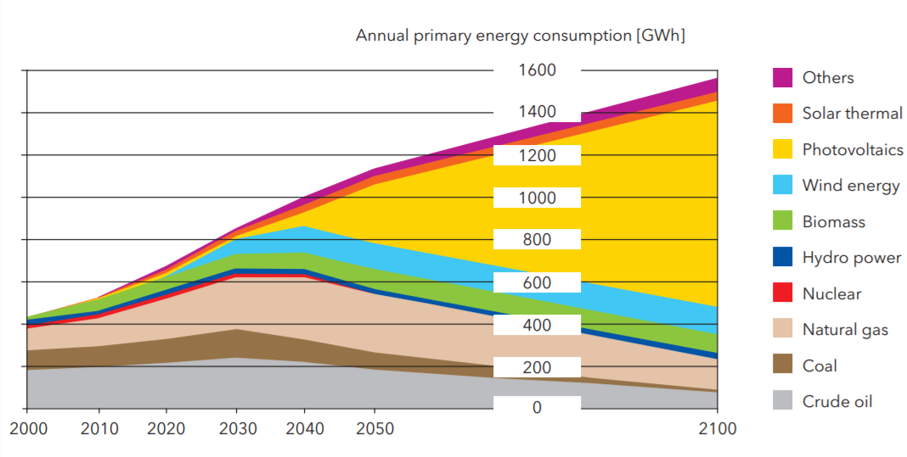
Where do we get our energy?
https://www.hessen-nanotech.de/mm/NanoEnergy_web.pdf

Slide 2
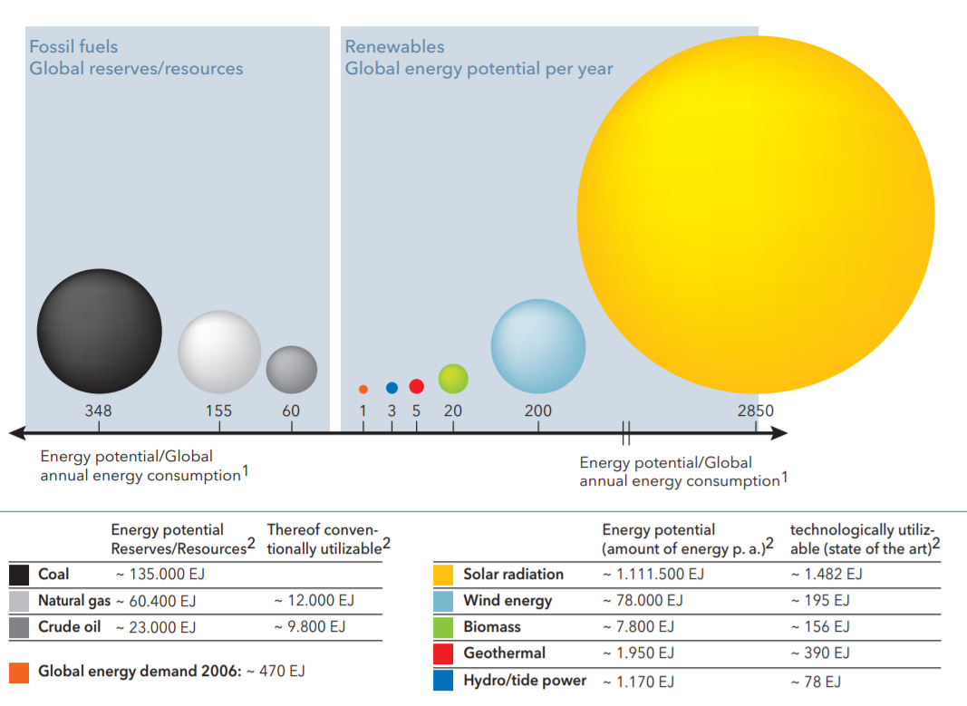
The sun holds the most energy potential
https://www.hessen-nanotech.de/mm/NanoEnergy_web.pdf

Slide 3
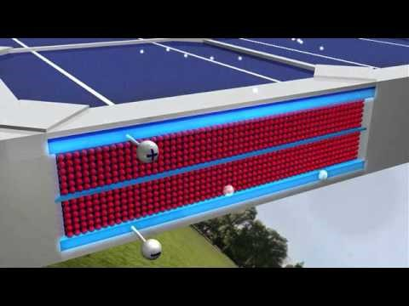
Video: Solar Energy and Photovoltaics 101
U.S. Department of Energy

Slide 4
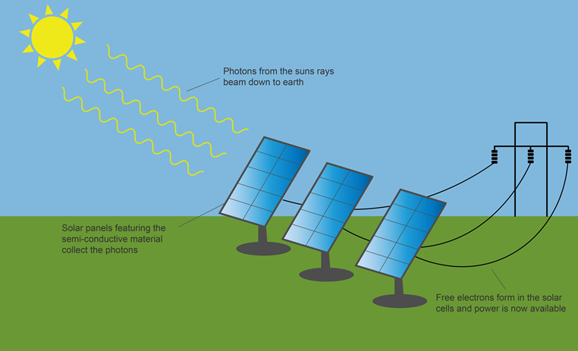
Solar cells transform solar energy into electricity
www.aurorasolar.com

Slide 5
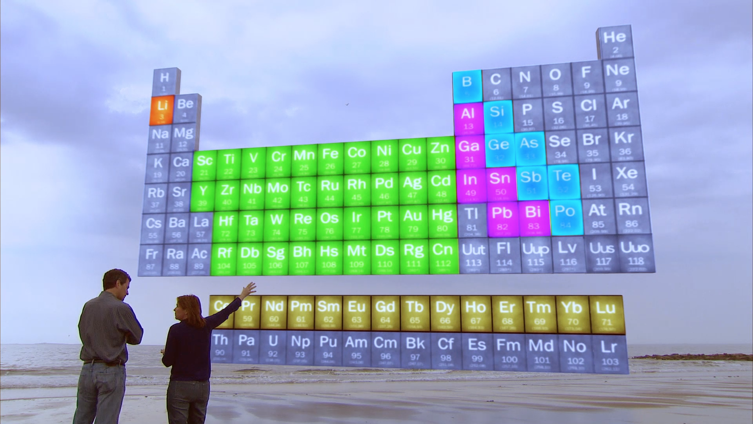
Solar materials are composed of specific elements

Slide 6
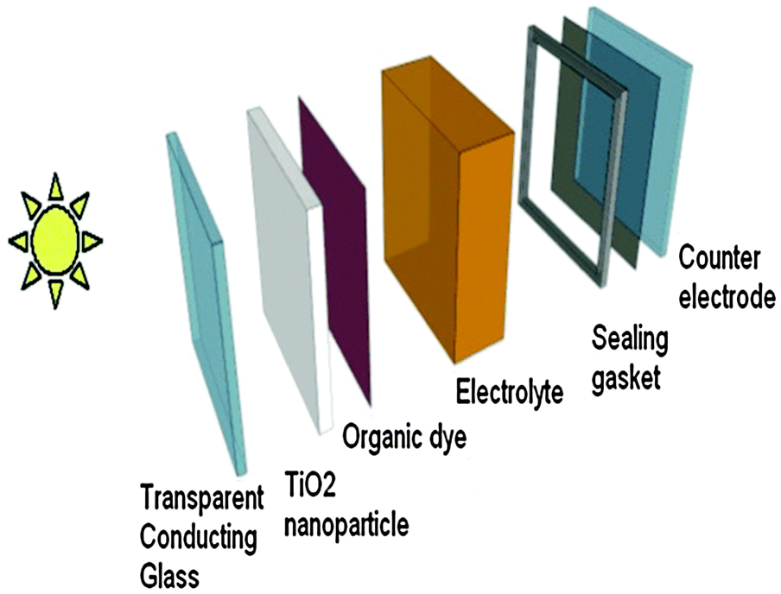
The basic components of a dye-sensitized solar cell
Reddy et al. Phys Chem Chem Phys (2014)

Slide 7
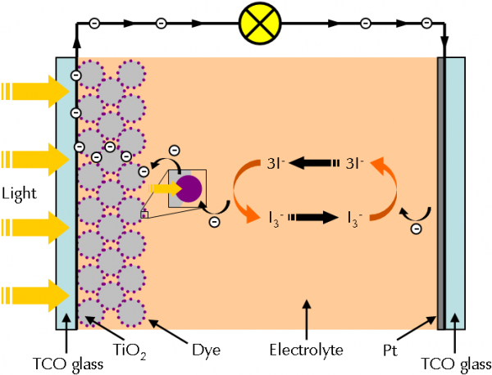
How do dye-sensitized solar cells work?
Dye molecules are excited by incident light, causing transfer of electrons from the dye to the semiconducting TiO₂ layer
Positions with lost electrons are called “holes”
The electrons leave the TiO₂ and travel through the circuit to the counter electrode
This movement of electrons is what we call electricity
The dye molecules are returned to their original state by electron transfer from iodide (I⁻) in the electrolyte
The electrons that arrive at the counter electrode reduce triiodide (I₃⁻) back to iodide (I⁻)
http://www.gamry.com/application-notes/physechem/dssc-dye-sensitized-solar-cells/

Slide 8
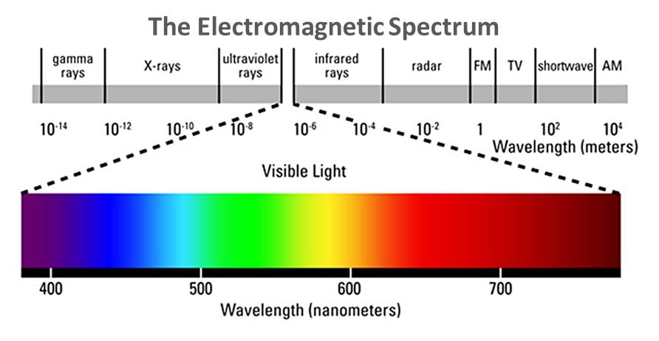
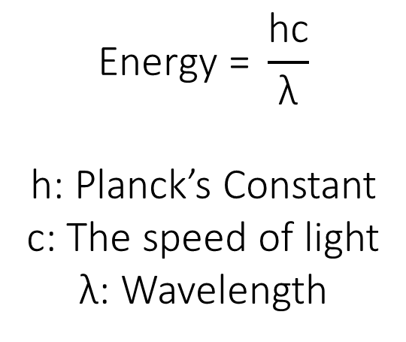
What is the relationship between the color of light and its energy?
$$\text{Energy}\text{ = }\frac{\text{hc}}{\text{λ}}$$
h: Planck’s Constant
c: The speed of light
λ: Wavelength

Slide 9
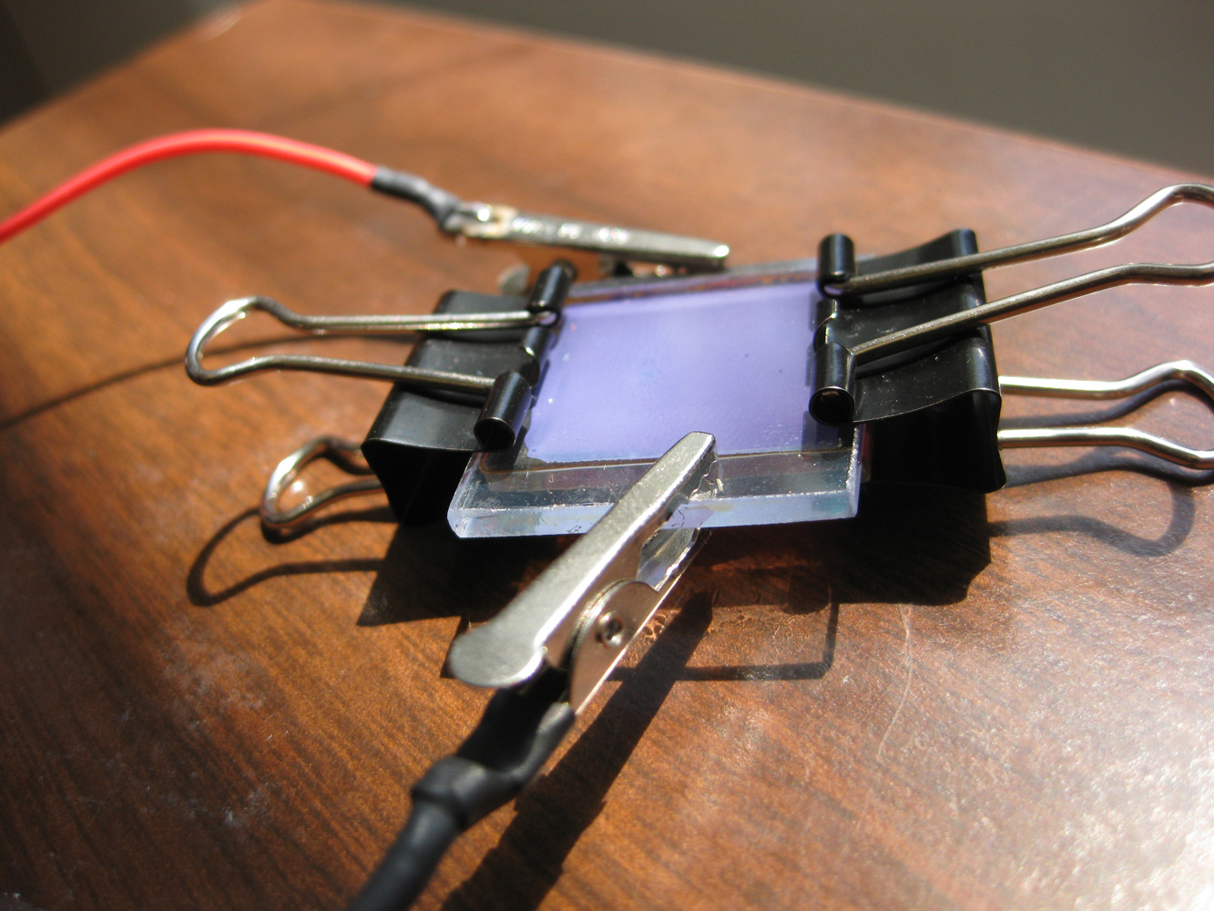
Today’s Activities: Building and exploring solar cells
http://www.nisenet.org/sites/default/files/images/catalog/5553/dssc.jpg

Slide 10
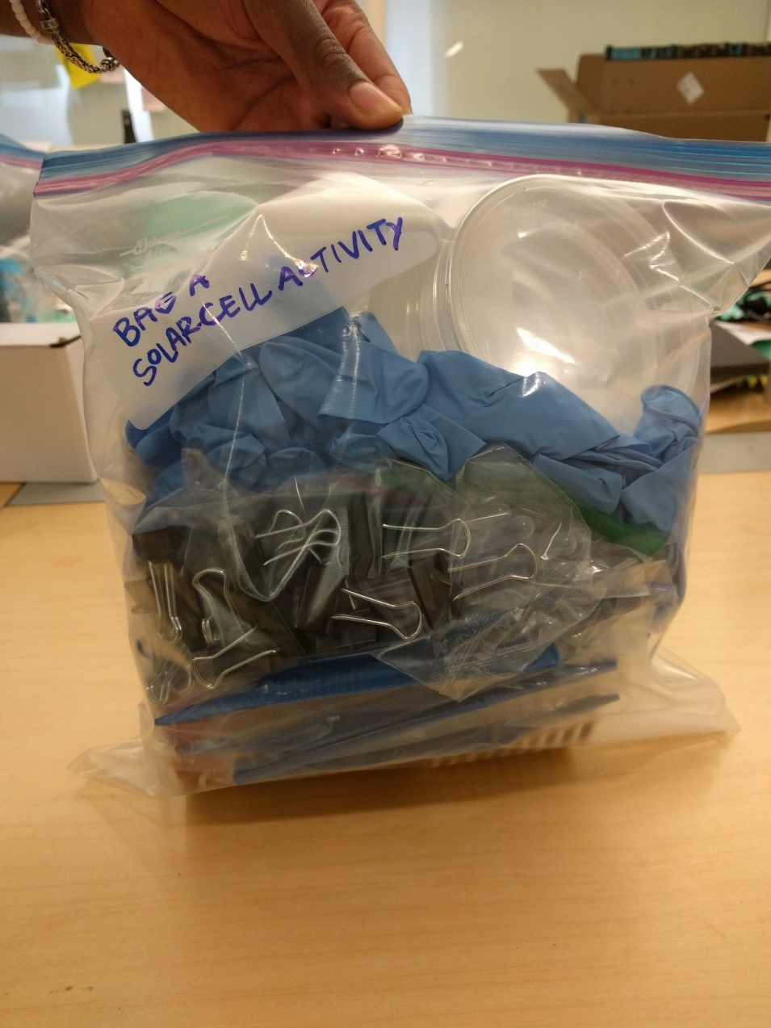
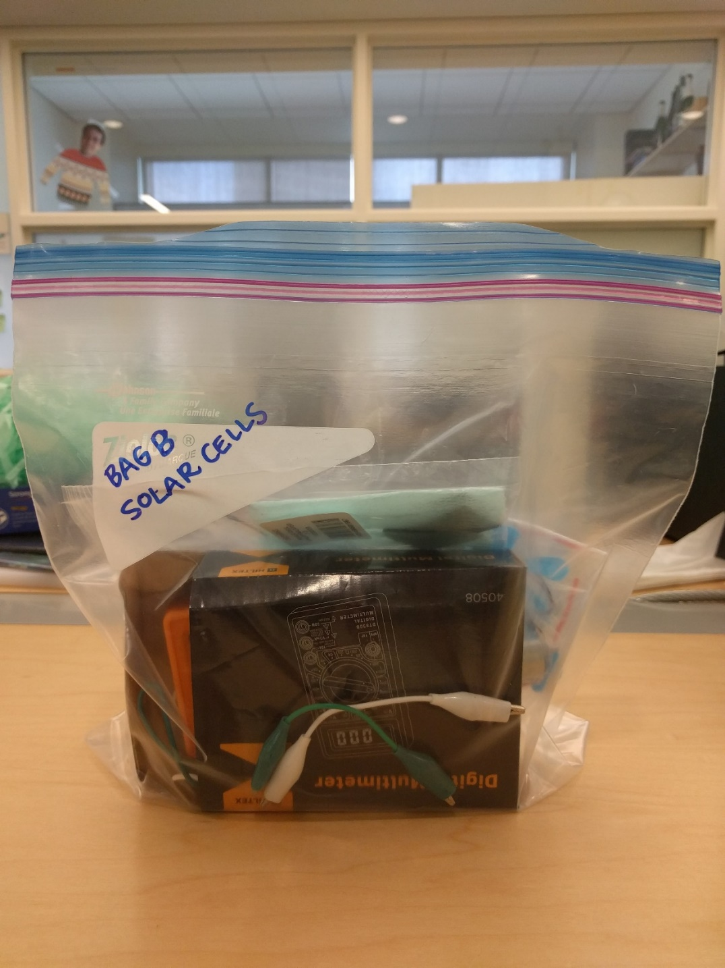
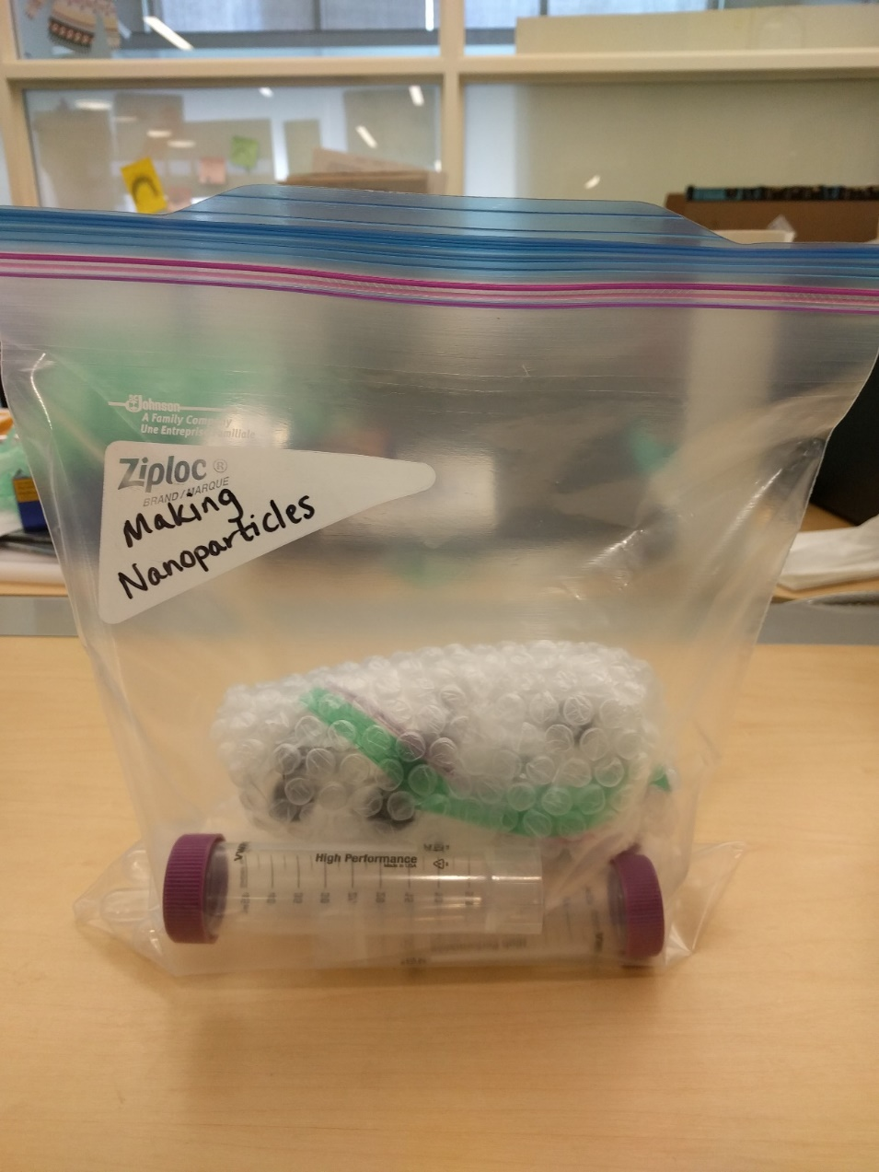
Each team should have three bags
Solar Cell Bag A
Solar Cell Bag B
Making Nanoparticles

Slide 11
Each team should have three bags
Save this for later
Solar Cell Bag A
Solar Cell Bag B
Making Nanoparticles

Slide 12
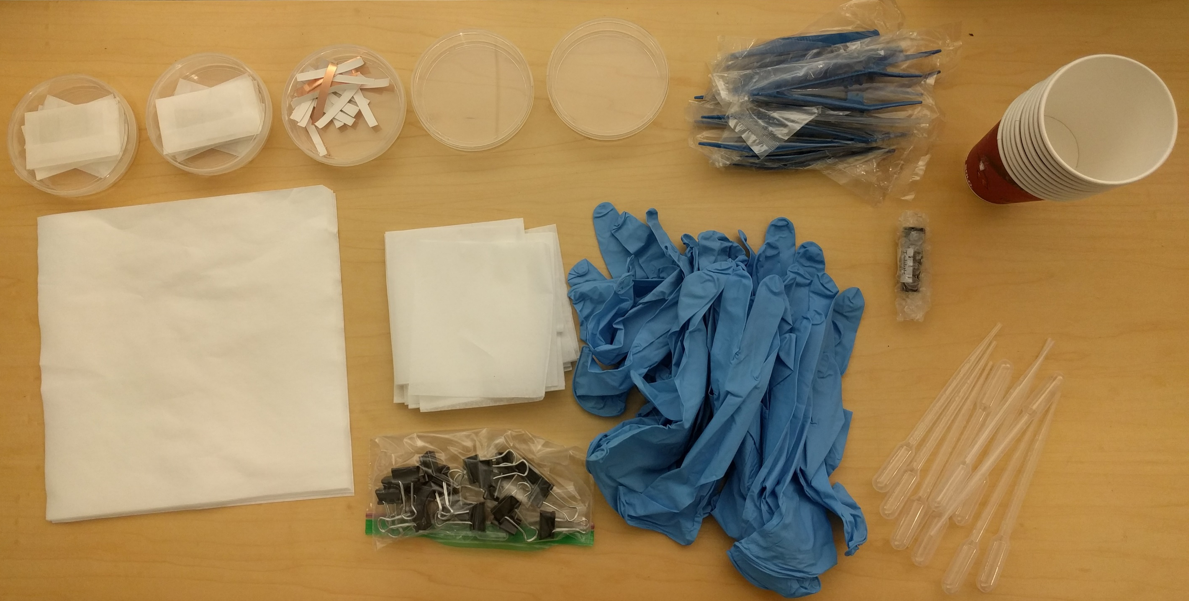
What’s inside Solar Cell Bag A?
1 Petri Dish of Copper Tape
10 Plastic Tweezers
2 Petri Dishes of Electrodes
2 Empty Petri Dishes
10 Paper Cups
Gloves
1 Vial of Electrolyte
Tissue Wipers
10 Absorbent Sheets
10 Large Disposable Pipettes
20 Binder Clips + 20 Small Plastic Pipettes

Slide 13
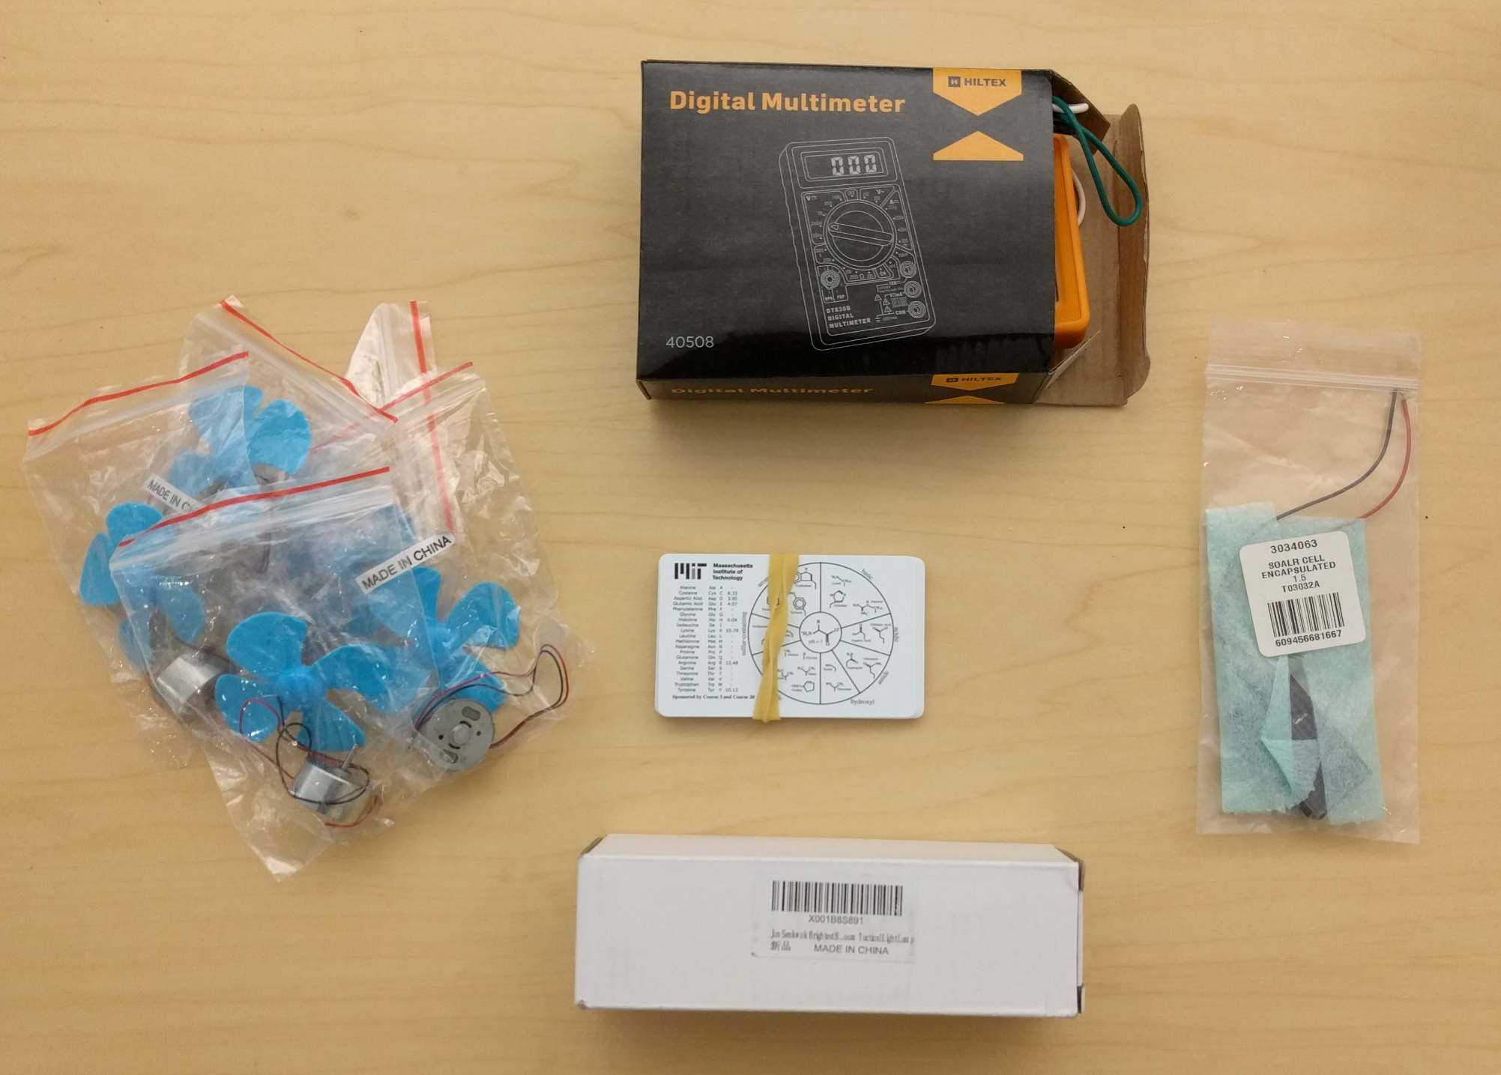
What’s inside Solar Cell Bag B?
1 Multimeter
4-5 Motors with Propellors
10 Periodic Table Cards
1-2 Flashlights
1 Commercial Solar Cell

Slide 14
Video: Building a solar cell
PLEASE Insert video named StudentVideoNEW.mp4 into this slide. Video was too large for github to store.

Slide 15
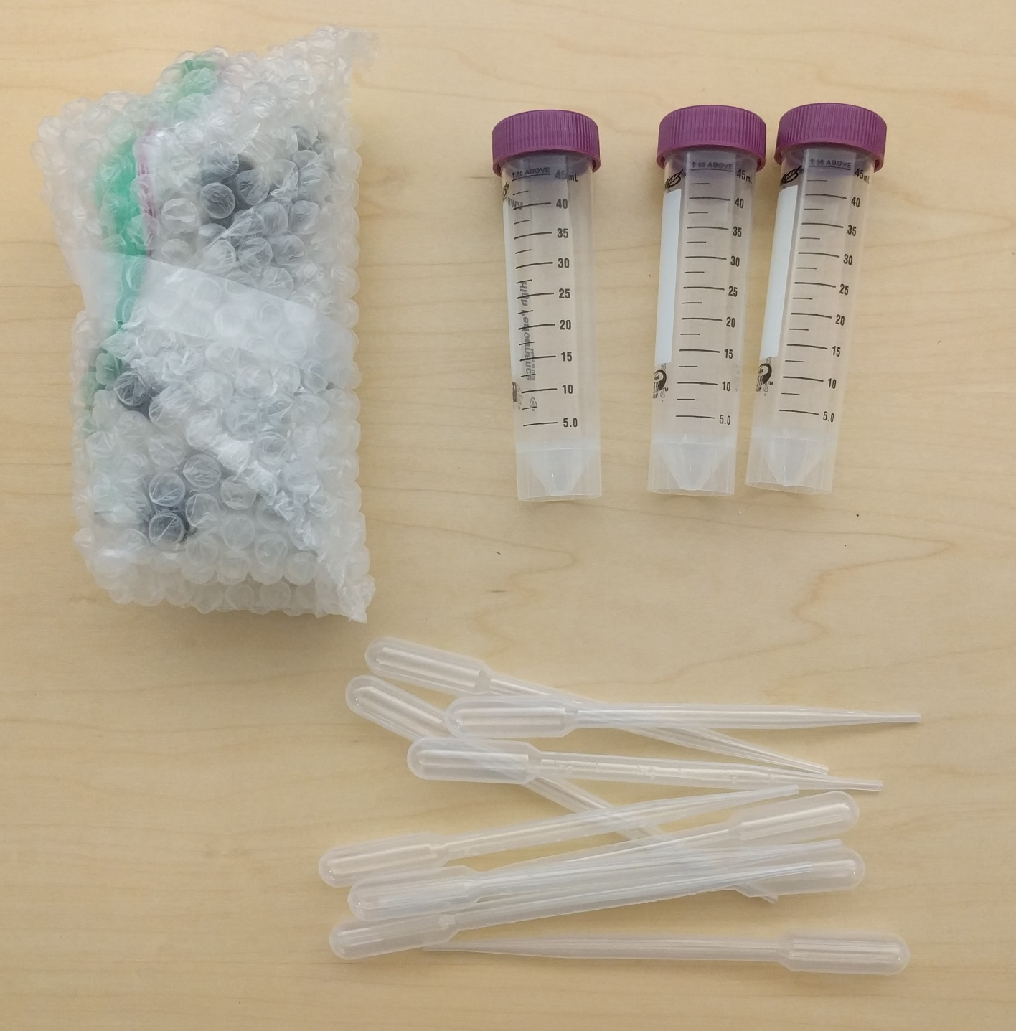
What’s inside the Making Nanoparticles Bag?
3 50mL Tubes
10 Large Plastic Pipettes
20 Small Vials

Slide 16
Extra Slides

Slide 17
Questions for discussion
Why might we have chosen transparent glass as our electrode material?
Why did the solar cell respond differently when we changed the color of light shining on it?
If electrons are moving from one location to another, why does charge not build up in the device?
How do you think solar cell performance would change if we did not include the dye? Why?

Slide 18
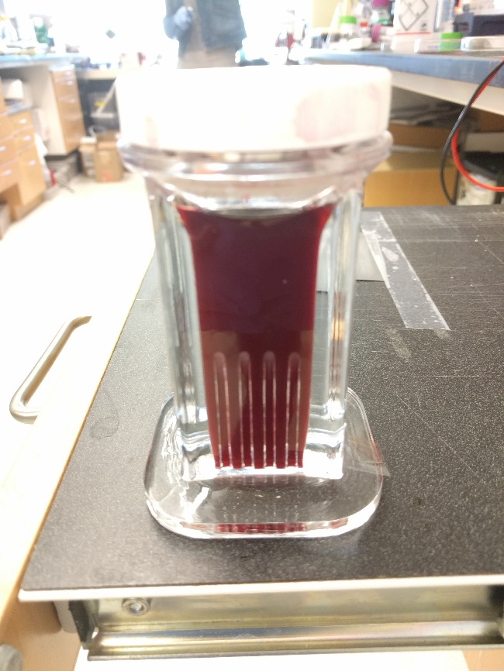
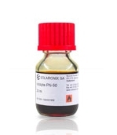
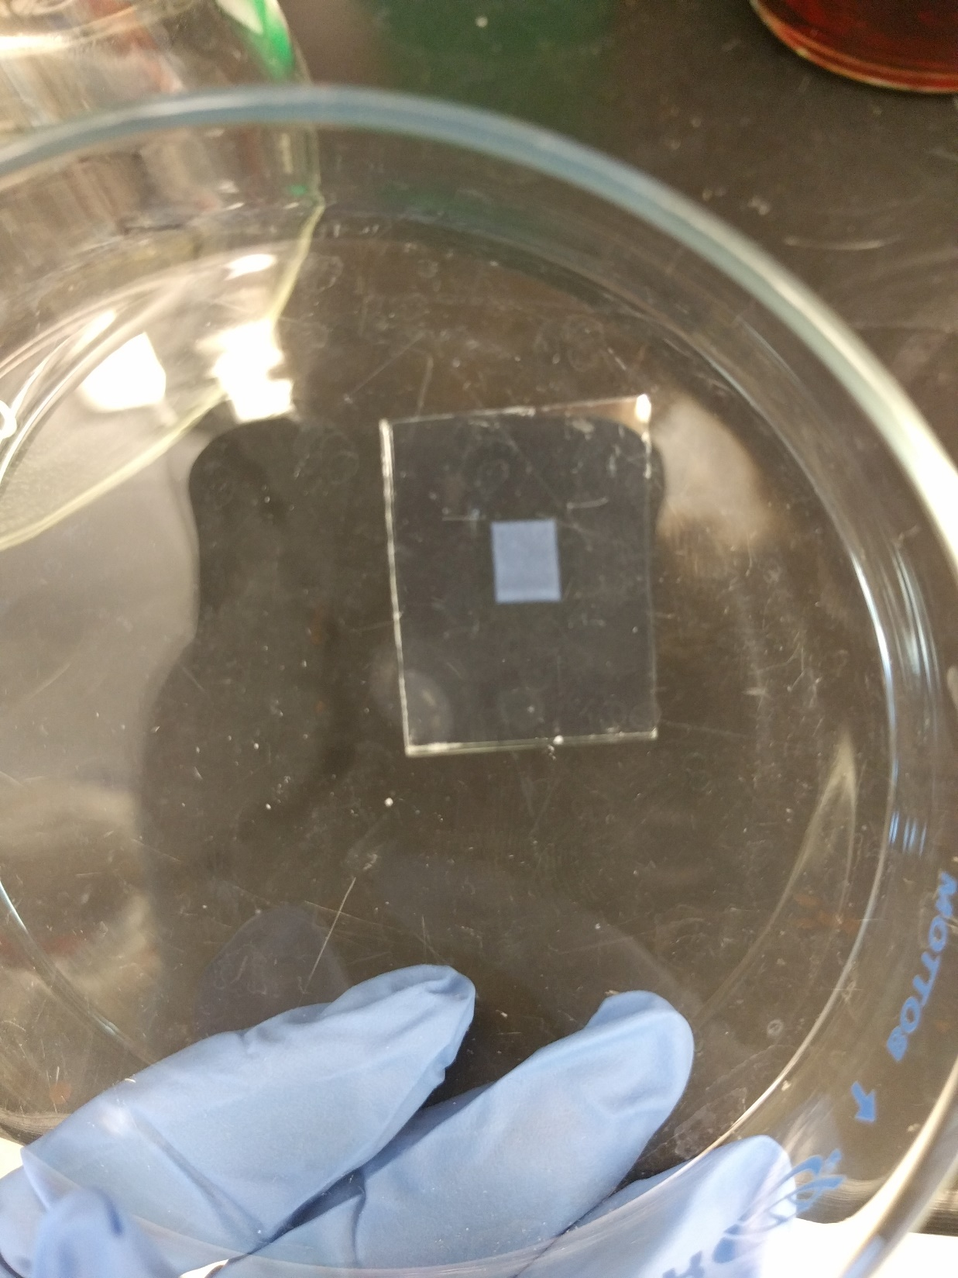
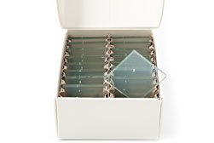
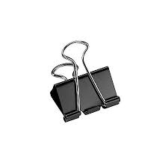
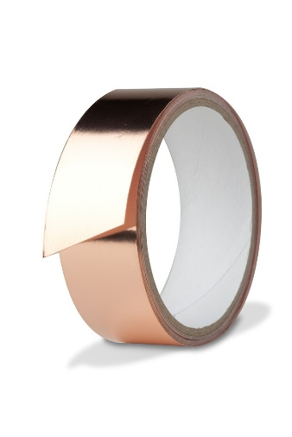
Today’s Activity: Build your own solar cell
Materials
Conducting glass coated in TiO₂
Platinum counter electrode
Binder clips
Copper tape
Iodine-based electrolyte solution
Organic dye: Hibiscus tea or berry juice

Slide 19
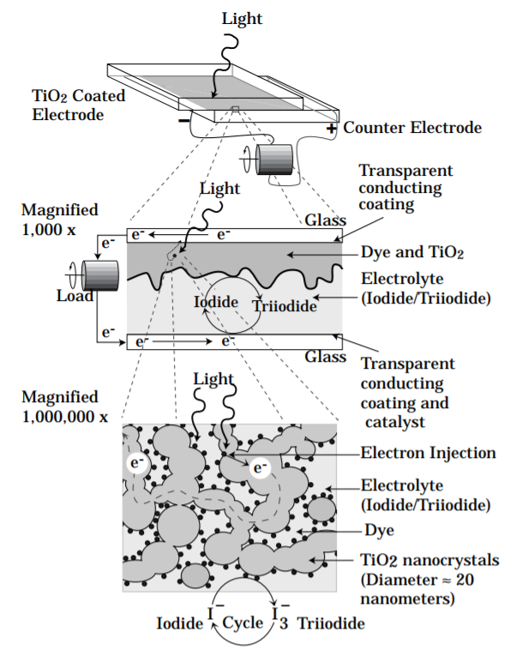
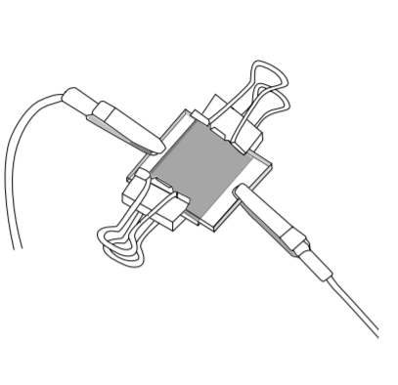
Today’s Activity: Build your own solar cell
Smestad and Gratzel, J Chem Ed (1998)

